Slide 1
R-Ladies Louisville June Meeting
library(dplyr)
rladies_global %>%
filter(city == ‘Louisville')

Slide 2





More info #RLadiesLouisville
Github (resources,
presentations, ...)
Twitter
Meetup
E-mail
Coming soon!
@RLadiesLouville
meetup.com/rladies-louisville/
louisville@rladies.org
Be a speaker!
Host an event!
Watch for upcoming meetups (meetup/twitter)!
get involved!
Notes:
Last Slide of Meeting

Slide 3
Presentations:
Sam Carlisle: Using R Statistical Computing for Breast Cancer Research
April Schweinhart: Using Markdown to make repetitive reporting a breeze
A special thanks to:
Heine Bros Coffee
Crescent Hill Library

Slide 4

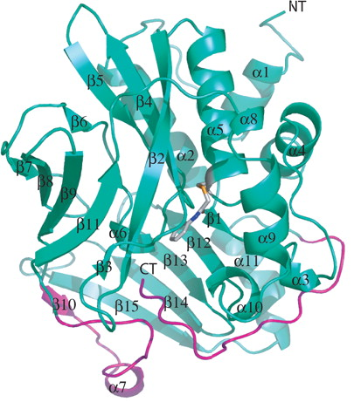

Using R Statistical Computing for Breast Cancer Research
Samantha Carlisle, MS
Adapted from Hong Wu et al. J. Biol. Chem. 2007;282:30189-30197

Slide 5

OUTLINE
Background
NATs
Breast Cancer
Results & Conclusions
Publicly Available Cancer Data
R Packages Utilized
Accession of Data (FirebrowseR)
Analysis/Plotting of Data (base R, dplyr, tidyr, ggplot2, & corrplot)

Slide 6
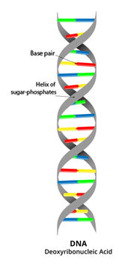
IMPORTANT TERMS TO KNOW
Gene- a sequence of DNA that contains instructions for making a molecule (protein) that has a specific function
Protein- gene product
perform a vast array of functions within humans, including mediating metabolic reactions, DNA replication, responding to stimuli, and transporting molecules from one location to another
Enzyme- specific class of proteins that help change one molecule to another
Notes:
Humans have approximately 20,000 genes

Slide 7
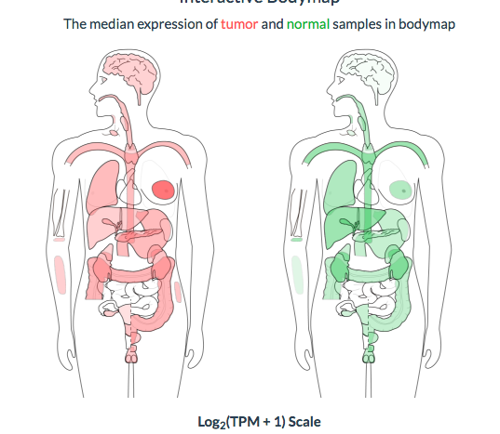
ARYLAMINE N-ACETYLTRANSFERASE 1
found in all parts of the human body
present in nearly every animal, fungi, & bacteria species
activity varies in humans
some breast cancer samples (ER+) have much higher amounts of this enzyme
Breast cancer will account for
30% of new cancer cases
14% of cancer related deaths
Five-year relative survival rate when diagnosed at
localized stage is 98.5%
distant stage only 25%
NAT1 TISSUE
DISTRIBUTION
Tumor
Normal
Notes:
These statistics highlight the need for a better understanding of breast cancer risk and progression so it can be detected in the earliest stages when it’s the most treatable

Slide 8
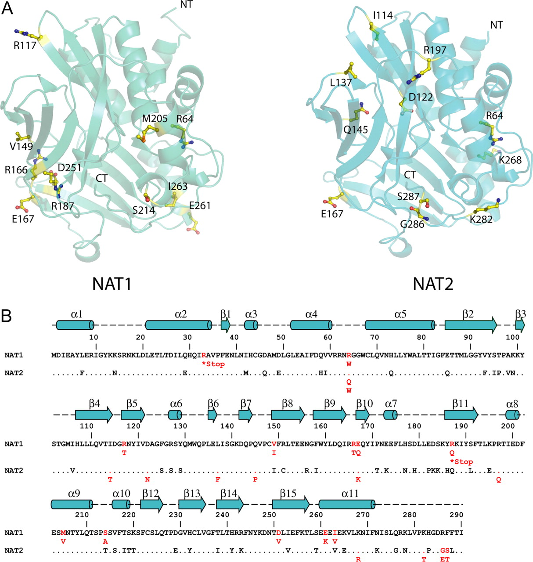
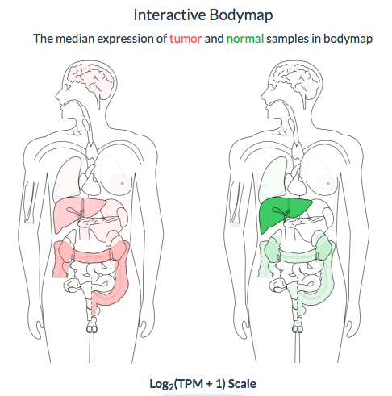
NAT1 vs NAT2
very similar functions
Both located on chromosome 8
can transform similar/same substances
NAT2 is found in many less parts of the body
NAT2
Tumor
Normal
Notes:
approximately 87% identical in terms of instructions from DNA

Slide 9
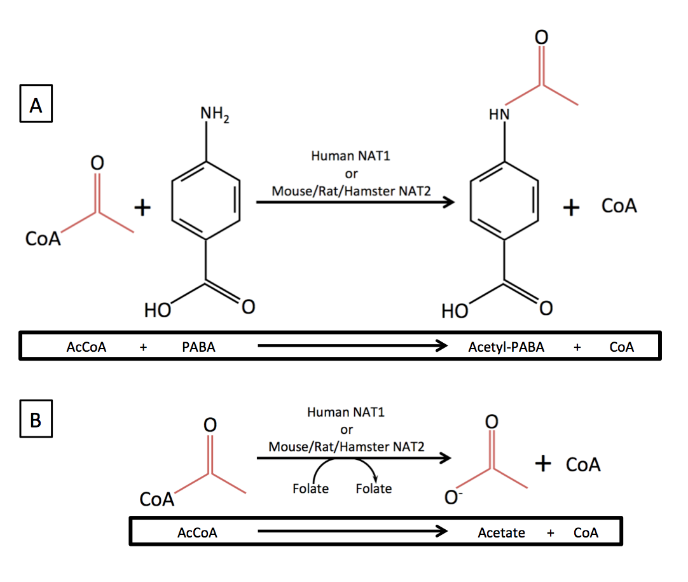
NAT1/NAT2 REACTION
certain medications & cancer causing substances found in cigarette smoke, well-done red meat, dyes
Human NAT1/NAT2
chemicals that our body can get rid of

Slide 10
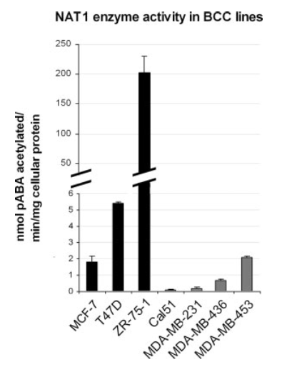
NAT1 ACTIVITY VARIES GREATLY IN BREAST CANCER CELL LINES
NAT2 ACTIVITY?
Wakefield, L., et al., Arylamine N-acetyltransferase 1 expression in breast cancer cell lines: a potential marker in estrogen receptor-positive tumors. Genes Chromosomes Cancer, 2008. 47(2): p. 118-26.

Slide 11
WHAT IS THE RELATIONSHIP BETWEEN NAT1 AND NAT2 EXPRESSION IN BREAST CANCER?
Carlisle, SM and Hein, DW. (2018). Analysis of estrogen receptor 1 and N-acetyltransferase gene expression in normal breast tissue, primary breast tumors, and established breast cancer cell lines. International Journal of Oncology.

Slide 12
EVALUATING NORMALITY OF DATA
Packages Used:
ggpubr

Slide 13
NAT1 EXPRESSION IS HIGHER THAN NAT2 IN BREAST TISSUES AND CELL LINES
Packages Used:
ggplot2, ggsignif

Slide 14
CORRELATION NAT1 & ESR1 > NAT1 & NAT2 > NAT2 & ESR1
Package Used:
corrplot

Slide 15
ESR1 & NAT1 EXPRESSION ARE INCREASED IN ER+ BREAST CANCER SAMPLES BUT NOT NORMAL BREAST TISSUE
Packages Used:
ggplot2, ggsignif

Slide 16
ESR1, NAT1, & NAT2 EXPRESSION ARE INCREASED IN PRIMARY TUMOR TISSUE
Packages Used:
ggplot2, ggsignif

Slide 17
NAT1 EXPRESSION STRONGLY CORRELATES WITH NAT1 N-ACETYLATION ACTIVITY
p<0.001
r=0.986
Packages Used:
ggplot2,
ggrepel

Slide 18
NAT1 & NAT2 EXPRESSION IN ESTABLISHED BREAST CANCER CELL LINES
Packages Used:
ggplot2, ggrepel

Slide 19
CONCLUSIONS
When studying NAT1 in breast cancer we (researchers) frequently don’t consider NAT2 expression and assume it is too low to be important
BUT NAT1 and NAT2 are very similar in terms of structure and chemicals they transform so its important to consider NAT2 expression in our studies
A better understanding of the relationship between NAT1 & NAT2 will impact development of drugs (currently in progress) that target NAT1

Slide 20
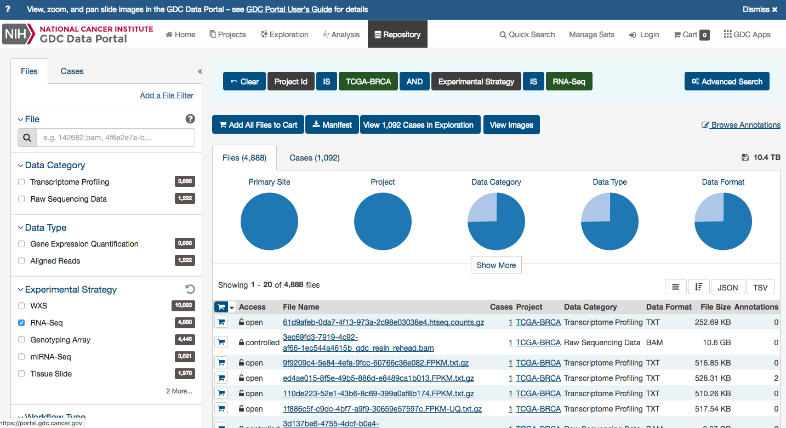
ACCESSING DATA
The Cancer Genome Atlas (TCGA) -tumor and normal tissue; difficult to download
The Cancer Cell Line Encyclopedia (CCLE) -established cancer cell lines; download 789 MB file then import into R using readtable function

Slide 21
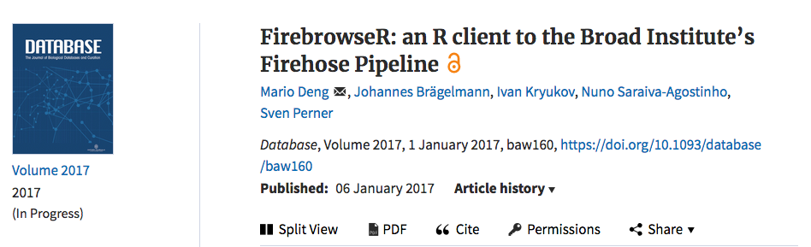
FIREBROWSER
Scope of FirebrowseR
R package designed to provide easy access to Firehose/TCGA datasets for R programmers. This package does not provide any additional functions, methods or tools to (pre-) process, analyze or evaluate the datasets.

Slide 22
PACKAGES USED FOR PLOTTING
dplyr/tidyr —rearranging data structure
ggplot2 —main package for plotting
ggpubr —used to visually evaluate normality of data
ggrepel —used to make sure labels of data points do not overlap and are readable
ggsignif —used to add significance denotation to figures
corrplot —used to make correlation matrices
Notes:
Use time here to say I have learned what I need to as I go…I learn best through examples

Slide 23
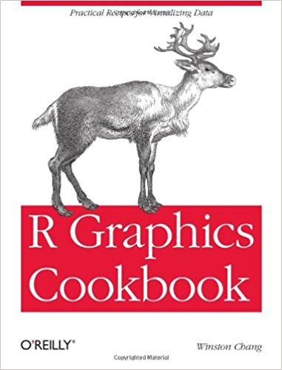

RESOURCES
ggplot2 “cheatsheet”: https://www.rstudio.com/wp-content/uploads/2015/03/ggplot2-cheatsheet.pdf (FREE)
R Graphics Cookbook (~$35 for hard-copy book or ~$18 for ebook)

Slide 24
ACKNOWLEDGEMENTS
Dr. David Hein
Patrick Trainor, MS, MA
R and RStudio Developers
R-Ladies Global
Funding and Support
United States Public Health Service grant T32-ES011564

Slide 26
Using Markdown to make repetitive reporting a breeze
library(dplyr)
rladies_global %>%
filter(city == ‘Louisville')

Slide 27


Hello!
April Schweinhart, PhD
Associate Research Scientist
Pacific Institute for Research and Evaluation
aschweinhart@pire.org

Slide 28

Why
What
How
Any questions?

Slide 29
Why use Markdown?
1) Organization: Everything in one spot, forever
2) Link to the Past: The analysis code is right there with the report, connected to the data itself.
3) Reproducible Reporting: Want to know what numbers went into that chart or model? The code is right there.
4) Push Button Updates: You finish the 15 page report, you find 100 more rows of data. Your entire report gets updated by pushing a button!

Slide 30




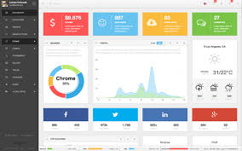
Transferability

Slide 31
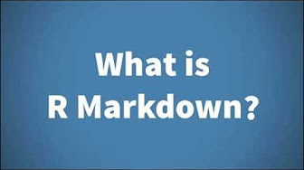
What is it?

Slide 32

Wait but…What is it?
It’s a package! install.packages(“rmarkdown”)
R markdown combines plain text writing of markdown with R code in one document - an r markdown file (.rmd)
Your file is all in one:
Links to data
Analysis
Text
Visuals
MIND = BLOWN

Slide 33
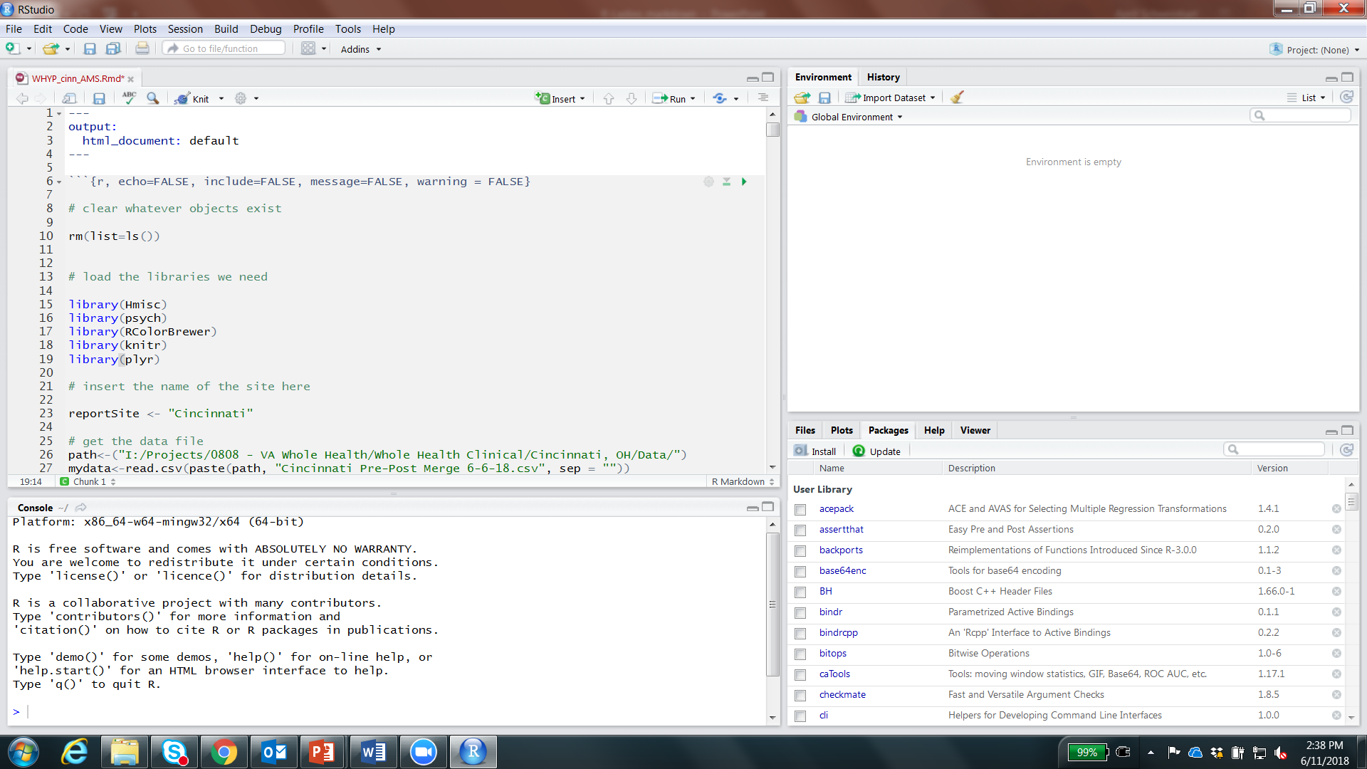
An r markdown file
New button!

Slide 34
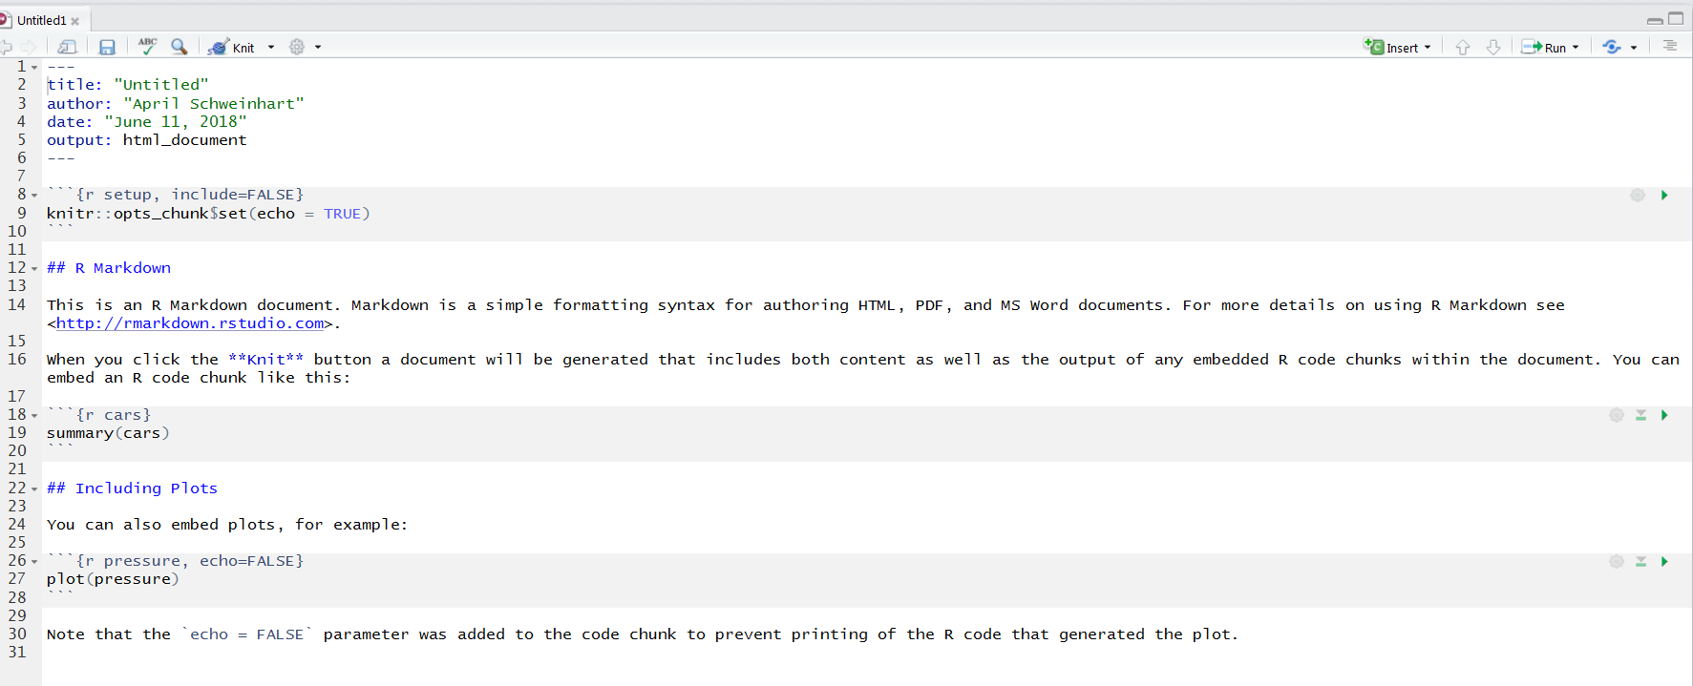
New .rmd file
File -> new -> r markdown file

Slide 35
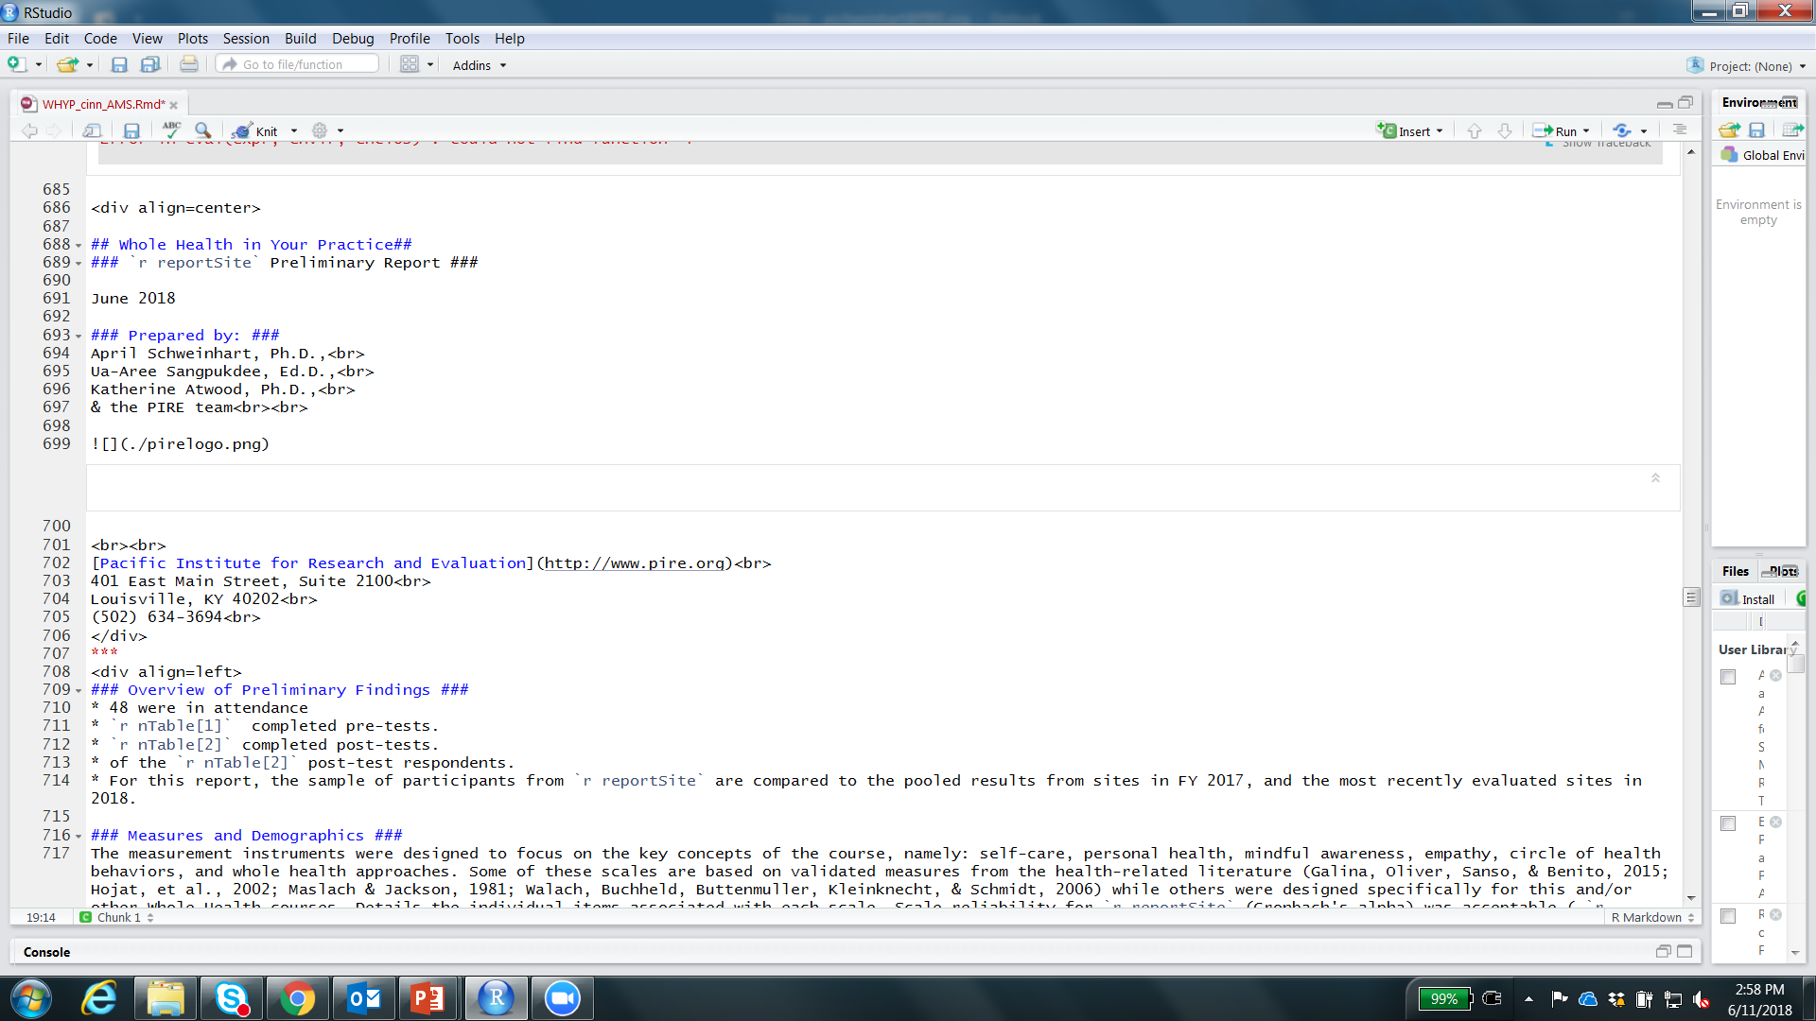
New code – text!

Slide 36

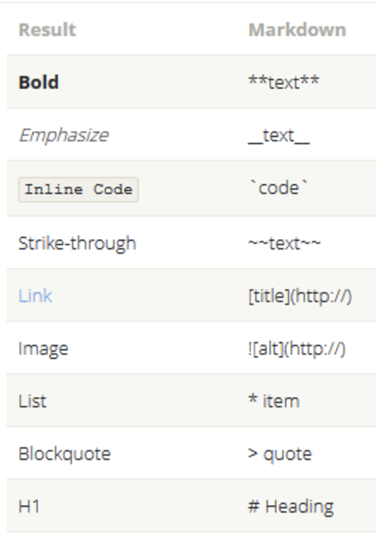
Easy Formatting

Slide 37
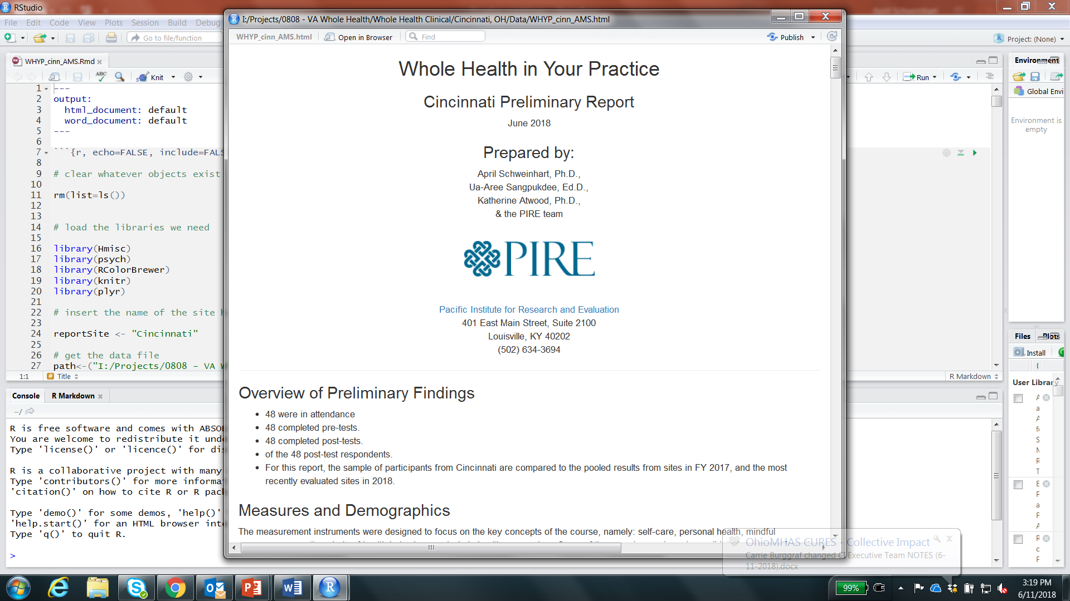
Knitted markdown text

Slide 38
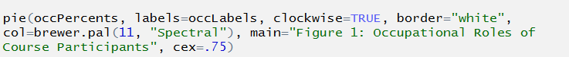
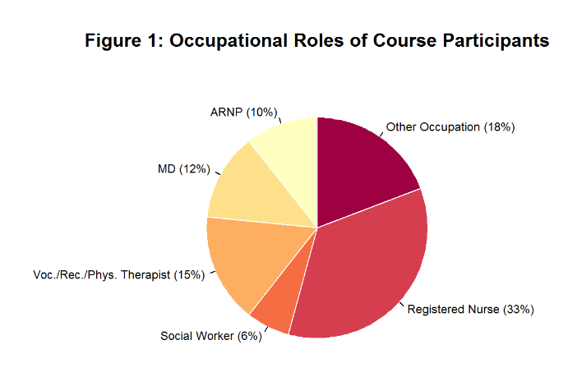
Knitted markdown chart

Slide 39
Transferability

Slide 40
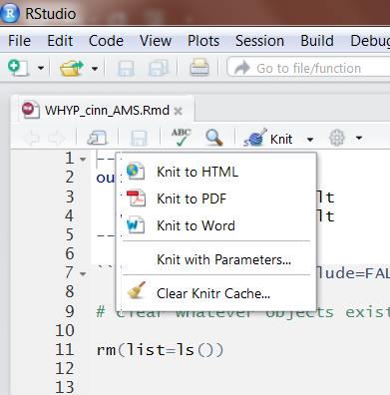
Knit to different options instantly

Slide 41
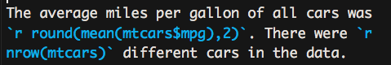
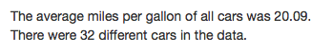
In-line output
Best feature of R Markdown for repetitive reporting
Calculate numbers/results in real time instead of typing them, and these outputs will update if your data ever change!
In any text section, use `r ` to write inline R code. The code goes after the “r”
Ability to preview as you go or knit drafts

Slide 42
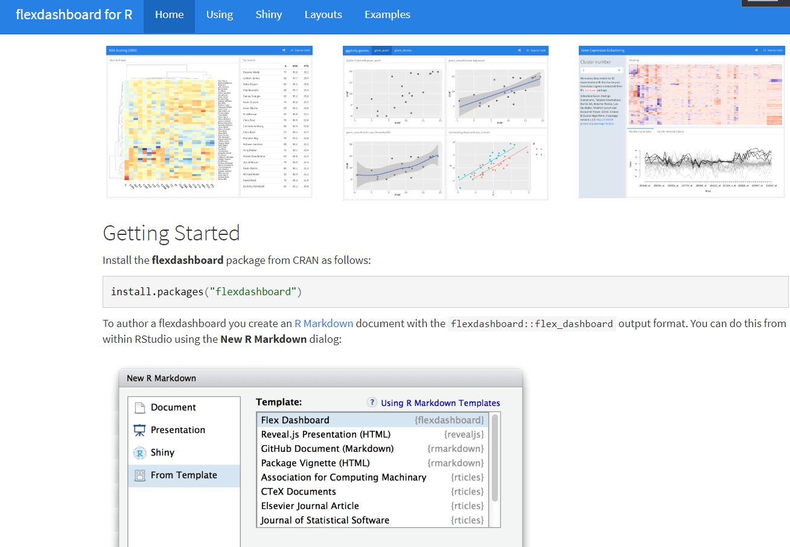
More advanced knitting
HTML document: readable in a browser, sharable with a link.
Knitting to PDF requires an installation of PanTex, (large download- but you only need to get it once).
Changing to a dashboard, slideshow, or other content requires a bit more work than just clicking “knit”.
Flexdashboard is a package that lets you use Markdown to make dashboards with shiny functionality.
http://rmarkdown.rstudio.com/flexdashboard/

Slide 43
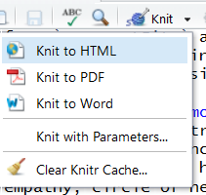
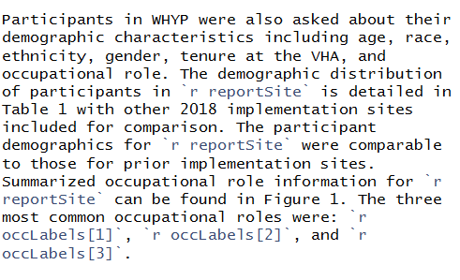
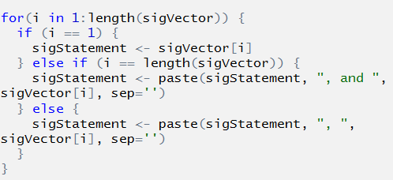
Easy as
1 2 3
Write analysis code
Write text of report with in-line code for changing pieces
Knit!

Slide 44
Open sourcing
Table of contents
Code folding
https://www.rstudio.com/wp-content/uploads/2015/03/rmarkdown-reference.pdf
The knitr package has a kable() function that makes nice looking tables for PDF, word, and HTML output.
kableExtra lets you do lots of cool things to kable() tables using pipes!
https://cran.r-project.org/web/packages/kableExtra/vignettes/awesome_table_in_html.html
Formattable has unique graphical functions for tables
https://github.com/renkun-ken/formattable

Slide 45
We live in a society exquisitely dependent on science and technology, in which hardly anyone knows anything about science and technology.”
—Carl Sagan

